Slide 1

Part Document Essentials
Presenter
Developer Technical Services

Slide 2
Agenda
2D Sketches
Sketch Constraints
Profiles
Sketch based and other Features
3D Sketches
WorkFeatures
Lab: sketch creation lab

Slide 3
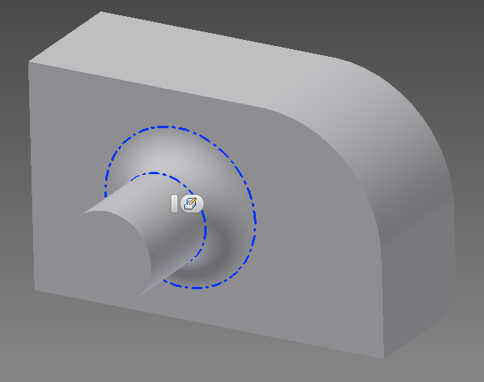
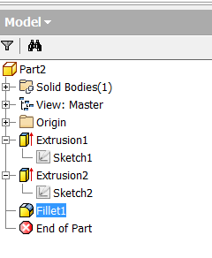
Goal: Creation of a Part through API
Steps:
Creation of Sketch1 (entities + constraints) to define shape of the 1st extrusion.
Creation of Extrusion1 using Sketch 1
Creation of Sketch2 on a face of the part.
Creation of Extrusion2 using Sketch 2
Creation of Fillet1 by selecting an edge.

Slide 4
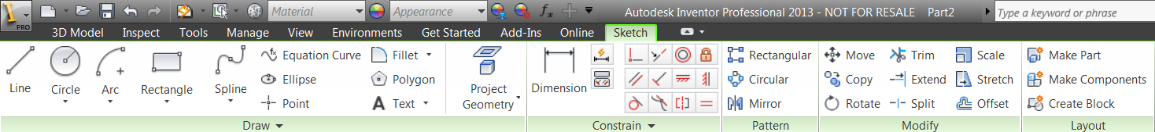
Sketches
Sketches are the building block for most features.
A Sketch consists of entities (lines, circles, etc.) whose behavior is controlled by geometric and dimension constraints.
Part Documents use the PlanarSketch object which is derived from the Sketch base class.

Slide 5
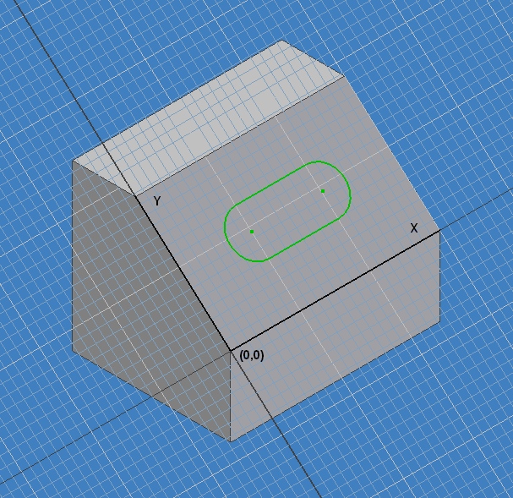
Sketches
Sketches contain true 2D geometry. (Are only defined by x and y coordinates.)
The sketch defines its own 2D coordinate system.
For parts and assemblies the sketch is positioned within 3D space relative to planar geometry (planar face or work plane).

Slide 6
Creating Planar Sketches
Add(PlanarEntity As Object, [UseFaceEdges As Boolean = False]) As PlanarSketch
Equivalent to the 2D Sketch command.
Orientation is determined automatically.
Can optionally include the edges of the input face.
AddWithOrientation(PlanarEntity As Object, AxisEntity As Object, _
NaturalAxisDirection As Boolean, AxisIsX As Boolean, _
Origin As Object, [UseFaceEdges As Boolean = False]) As PlanarSketch
API only functionality that allows you to create a sketch fully defining the orientation by providing the entities that will be used to control the orientation.
PlanarEntity: Valid input includes planar faces and work planes.
AxisEntity: Valid input includes linear edges, sketch lines from another sketch, and work axes.

Slide 7
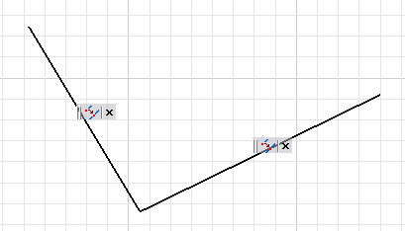
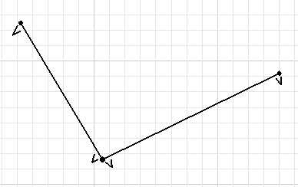
Sketch Entity Basics
Sketches consist of:
sketch entities
geometric constraints
dimension constraints
Sketch entities are always associated to sketch points and are connected to the points by coincident constraints.
Two lines placed interactively.
Three points and four
geometric constraints
were created.

Slide 8
Sketch Entities
When creating sketch entities you can define coordinates in two ways depending on the desired result:
Using a Point2d object which will result in the creation of a sketch point at the coordinate defined by the Point2d object.
Using an existing SketchPoint object. The sketch entity will be created using the input SketchPoint.

Slide 9
Model Space and Sketch Space
A sketch is a 2D plane within a 3D model space. Sometimes it is convenient to go from one space to another:
ModelToSketchSpace – Takes a 3D point in model space and returns a 2D point that represents the 3D point projected onto the sketch plane.
SketchToModelSpace – Takes a 2D point in sketch space and returns the equivalent 3D point in model space.
ModelToSketchTransform, SketchToModelTransform – Returns transformation matrix that defines these transforms.

Slide 10
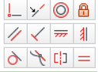
Sketch Geometric Constraints
Geometric Constraints
Define the behavior of single entities: ground, vertical, and horizontal.
Define the relationship between two entities: coincident, collinear, concentric, equal length, equal radius, horizontal align, midpoint, parallel, perpendicular, symmetry, tangent, and vertical align.
Dim oHorizontal As HorizontalConstraint
oHorizontal = oSketch.GeometricConstraints.AddHorizontal(oSketchLine1)
Dim oParallel As ParallelConstraint
oParallel = oSketch.GeometricConstraints.AddParallel(oSketchLine1, oSketchLine2)

Slide 11
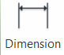
Sketch Dimension Constraints
Dimension Constraints
Defines the size of entities and the distance or angle between entities.
Many dimension constraints are to the sketch points.
The programming help provides good descriptions and pictures of the various dimension constraints in the descriptions of the different Add methods.
Dim oTwoPointDim As TwoPointDistanceDimConstraint
oTwoPointDim = oSketch.DimensionConstraints.AddTwoPointDistance(_
oSketchLine1.StartSketchPoint, _
oSketchLine1.EndSketchPoint, _
DimensionOrientationEnum.kAlignedDim, _
oTG.CreatePoint2d(3, 4), _
False)
Notes:
Here are the existing DimensionConstrainsts:
- DiameterDimConstraint
- EllipseRadiusDimConstraint
- OffsetDimConstraint Inventor
- OffsetSplineDimConstraint
- RadiusDimConstraint
- TangentDistanceDimConstraint
- ThreePointAngleDimConstraint
- TwoLineAngleDimConstraint
- TwoPointDistanceDimConstraint

Slide 12
Sketch Creation - Example (Create Points)
' get part componenet definition
Dim oCompDef As PartComponentDefinition
oCompDef = _InvApplication.ActiveDocument.ComponentDefinition
' add a sketch
Dim oSketch As PlanarSketch
oSketch = oCompDef.Sketches.Add(oCompDef.WorkPlanes.Item(3))
‘ get transient geometry
Dim oTG As TransientGeometry
oTG = _InvApplication.TransientGeometry
‘create some sketch lines
Dim oLines(2) As SketchLine
oLines(0)= oSketch.SketchLines.AddByTwoPoints(oTG.CreatePoint2d(0, 0), oTG.CreatePoint2d(3, 0))
oLines(1)= oSketch.SketchLines.AddByTwoPoints(oLines(0).EndSketchPoint, oTG.CreatePoint2d(0, 2))
oLines(2)= oSketch.SketchLines.AddByTwoPoints(oLines(1).EndSketchPoint, oLines(0).StartSketchPoint)
‘ constraint the lines: horizontal and vertical
Call oSketch.GeometricConstraints.AddHorizontal(oLines(0))
Call oSketch.GeometricConstraints.AddVertical(oLines(2))
‘ add dimensions
Call oSketch.DimensionConstraints.AddTwoPointDistance(oLines(0).StartSketchPoint, _
oLines(0).EndSketchPoint, _
DimensionOrientationEnum.kHorizontalDim, _
oTG.CreatePoint2d(1.5, -0.5))
Call oSketch.DimensionConstraints.AddTwoPointDistance(oLines(2).StartSketchPoint, _
oLines(2).EndSketchPoint, _
DimensionOrientationEnum.kVerticalDim, _
oTG.CreatePoint2d(-0.5, 1))

Slide 13
Sketch Creation - Example (UseExisting Points)
‘ create points collection
Dim oPoints(2) As SketchPoint
oPoints(0) = oSketch.SketchPoints.Add(oTG.CreatePoint2d(0, 0), False)
oPoints(1) = oSketch.SketchPoints.Add(oTG.CreatePoint2d(3, 0), False)
oPoints(2) = oSketch.SketchPoints.Add(oTG.CreatePoint2d(0, 2), False)
‘ create lines collection
Dim oLines(2) As SketchLine
oLines(0) = oSketch.SketchLines.AddByTwoPoints(oPoints(0), oPoints(1))
oLines(1) = oSketch.SketchLines.AddByTwoPoints(oPoints(1), oPoints(2))
oLines(2) = oSketch.SketchLines.AddByTwoPoints(oPoints(2), oPoints(0))
‘ constraint lines
Call oSketch.GeometricConstraints.AddHorizontal(oLines(0))
Call oSketch.GeometricConstraints.AddVertical(oLines(2))
‘ add dimensions
Call oSketch.DimensionConstraints.AddTwoPointDistance(oPoints(0), _
oPoints(1), _
DimensionOrientationEnum.kHorizontalDim, _
oTG.CreatePoint2d(1.5, -0.5))
Call oSketch.DimensionConstraints.AddTwoPointDistance(oPoints(2), _
oPoints(0), _
DimensionOrientationEnum.kVerticalDim, _
oTG.CreatePoint2d(-0.5, 1))
Notes:
'/////////////////////////////////////////////////////////////////////////////////////////////////////////////
'// Use: Creates a new part, adds a new sketch and create some entities with constraints
'//
'//
'/////////////////////////////////////////////////////////////////////////////////////////////////////////////
Public Sub CreateSketch()
'Create new part document
Dim oPartDoc As PartDocument
oPartDoc = _InvApplication.Documents.Add(DocumentTypeEnum.kPartDocumentObject, _
_InvApplication.FileManager.GetTemplateFile(DocumentTypeEnum.kPartDocumentObject), _
True)
Dim oPlanarEntity As WorkPlane
oPlanarEntity = oPartDoc.ComponentDefinition.WorkPlanes("XY Plane")
'Create new sketch
Dim oSketch As PlanarSketch
oSketch = oPartDoc.ComponentDefinition.Sketches.Add(oPlanarEntity)
Dim oTG As TransientGeometry
oTG = _InvApplication.TransientGeometry
'Create some sketch entities
Dim oLine As SketchLine
oLine = oSketch.SketchLines.AddByTwoPoints(oTG.CreatePoint2d(15, 5), oTG.CreatePoint2d(15, 0))
oLine = oSketch.SketchLines.AddByTwoPoints(oLine.EndSketchPoint, oTG.CreatePoint2d(0, 0))
oLine = oSketch.SketchLines.AddByTwoPoints(oLine.EndSketchPoint, oTG.CreatePoint2d(0, 10))
oLine = oSketch.SketchLines.AddByTwoPoints(oLine.EndSketchPoint, oTG.CreatePoint2d(10, 10))
Dim oArc As SketchArc
oArc = oSketch.SketchArcs.AddByCenterStartEndPoint(oTG.CreatePoint2d(10, 5), oSketch.SketchLines(1).StartSketchPoint, oLine.EndSketchPoint)
'Create some constraints
Dim oRadiusConstraint As RadiusDimConstraint
oRadiusConstraint = oSketch.DimensionConstraints.AddRadius(oArc, oTG.CreatePoint2d(15, 10))
Dim oGeoConstraint As VerticalConstraint
oGeoConstraint = oSketch.GeometricConstraints.AddVertical(oSketch.SketchLines(3), True)
'Fit the view
_InvApplication.ActiveView.Fit()
End Sub

Slide 14
Sketch Entity Creation and Edit
The DeferUpdates property will improve performance by turning off the sketch solver. Be careful of edits where you need the sketch to solve. Best to use during sketch creation.
Positional edits are performed by editing constraints or moving unconstrained sketch points.
Can Move or Rotate a set of sketch entities using the MoveSketchObjects Method. Reliable results are obtained by using this method to move or rotate the sketch points, (the attached geometry will automatically update).
Can determine if a sketch entity is fully constrained using the ConstraintStatus property of the entity.
Can copy all the contents of the sketch to the input target sketch. CopyContentsTo

Slide 15
Text in Sketches
The String that defines the text for a TextBox can define style changes within the string by using an XML like syntax. Defined in detail in the Help Files: see List of XML text formatting tags for FormattedText (Overviews)
' Create text with simple string as input.
' It doesn't use any text overrides,
' so it will use the active text style.
Dim sText As String
sText = "Drawing Notes"
Dim oTextBox As TextBox
oTextBox = oSketch.TextBoxes.AddFitted(oTG.CreatePoint2d(3, 18), sText)
' Create text using various overrides.
sText = "<StyleOverride Bold='True' Italic='True'>Notice</StyleOverride>: " & _
"Some Text" & _
"<StyleOverride Font='AIGDT'>n</StyleOverride>" & _
"Some other Text"
oTextBox = oSketch.TextBoxes.AddFitted(oTG.CreatePoint2d(3, 16), sText)

Slide 16
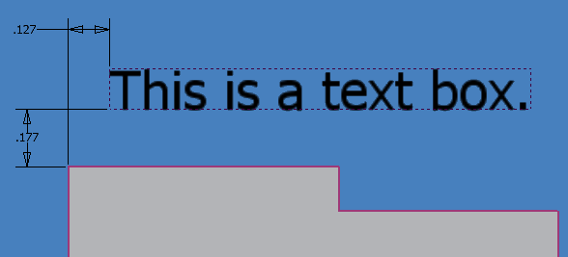
Text Box
Toggle the visibility of the boundary around the text box (which consists of sketch lines) using the ShowBoundaries property.
Access the sketch lines that define the boundary box using the BoundaryGeometry property.

Slide 17
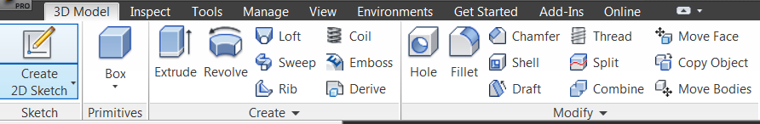
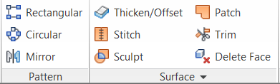
Part Features
Creation and advanced query is available for most features
General query functionality is available for all features.
Features are enumerated through the PartFeatures collection in the same order as they appear in the browser.

Slide 18
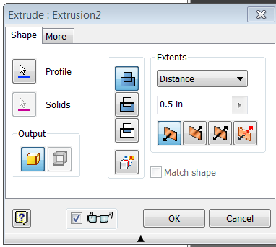
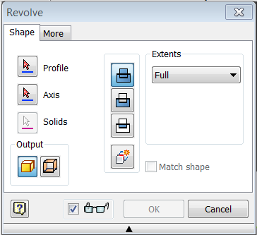
Sketch Based Features
Many features require sketches as input to define the shape or position of the feature; Extrude, Revolve, Hole, Rib, Loft, Sweep, Coil, Split, Emboss, and Boundary Patch.

Slide 19
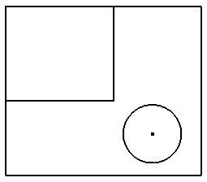
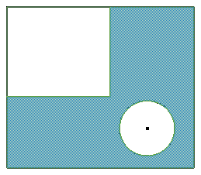
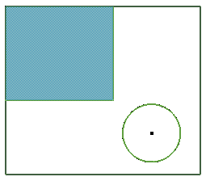
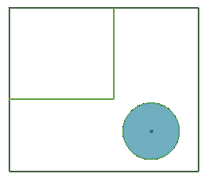
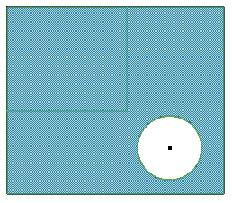
Profiles
Feature creation doesn’t directly take a sketch as input, but instead takes Profiles and Paths as input.
Profiles define the open or closed loops within a sketch that will be used for a feature.
Closed profiles consist of any combination of closed loops.
Open profiles consist of a single set of end-connected entities.

Slide 20
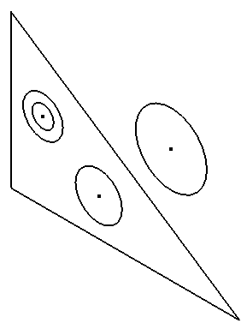
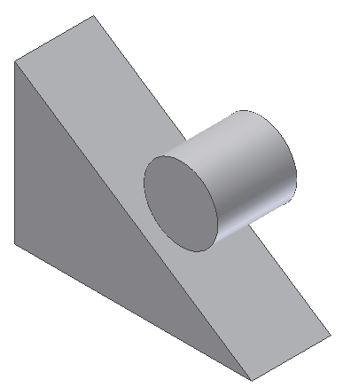
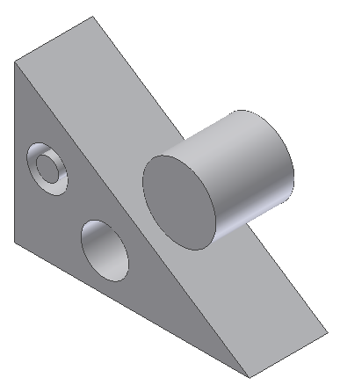
Creating Profiles
Profiles.AddForSolid([Combine As Boolean = True], _ [Curves], [reserved]) As Profile
Creates a profile for a closed set of sketch entities. Also supports a sketch containing a text box.
Curves argument is used to specify which sketch entities you want included in the profile.
Profiles.AddForSurface([Curve]) As Profile
Creates a profile for an open set of connected sketch entities.
Combine = False
Combine = True

Slide 21
Profile Object Model
Existing profiles consist of one or more ProfilePath objects which represent loops (open or closed) of the Profile.
ProfilePath objects can be deleted to remove paths from the Profile. The AddsMaterial property can also be modified.
A ProfilePath consists of one or more ProfileEntity objects or a text box.
PlanarSketch.UpdateProfiles causes all associated Profiles and any dependent features to be recomputed. (Used after editing a sketch using the API.)
Profiles are also used in drawings to define areas for color fill.
Notes:
'/////////////////////////////////////////////////////////////////////////////////////////////////////////////
'// Use: Demonstrate how to select ProfilePaths inside a Profile object
'//
'//
'/////////////////////////////////////////////////////////////////////////////////////////////////////////////
Public Sub CreateExtrusionFromModifiedProfile()
Dim oPartDoc As PartDocument
oPartDoc = _InvApplication.Documents.Add(DocumentTypeEnum.kPartDocumentObject, _
_InvApplication.FileManager.GetTemplateFile(DocumentTypeEnum.kPartDocumentObject), _
True)
Dim oTG As TransientGeometry
oTG = _InvApplication.TransientGeometry
Dim oPlanarEntity As WorkPlane
oPlanarEntity = oPartDoc.ComponentDefinition.WorkPlanes("XY Plane")
'Create new sketch
Dim oSketch As PlanarSketch
oSketch = oPartDoc.ComponentDefinition.Sketches.Add(oPlanarEntity)
'Create Sketch entities
Call oSketch.SketchLines.AddAsTwoPointRectangle(oTG.CreatePoint2d(0, 0), oTG.CreatePoint2d(10, 10))
Dim oCenter As SketchPoint
oCenter = oSketch.SketchPoints.Add(oTG.CreatePoint2d(5, 5))
Call oSketch.SketchLines.AddByTwoPoints(oSketch.SketchLines(1).StartSketchPoint, oCenter)
Call oSketch.SketchLines.AddByTwoPoints(oCenter, oSketch.SketchLines(3).StartSketchPoint)
Call oSketch.SketchLines.AddByTwoPoints(oSketch.SketchLines(1).EndSketchPoint, oCenter)
Call oSketch.SketchLines.AddByTwoPoints(oCenter, oSketch.SketchLines(3).EndSketchPoint)
'Create Profile
Dim oProfile As Profile
oProfile = oSketch.Profiles.AddForSolid
'Delete some Paths
Dim oProfilePath1 As ProfilePath
Dim oProfilePath2 As ProfilePath
oProfilePath1 = oProfile.Item(1)
oProfilePath2 = oProfile.Item(3)
oProfilePath1.Delete()
oProfilePath2.Delete()
'Create Extrusion
Dim oExtrudeFeatures As ExtrudeFeatures
oExtrudeFeatures = oPartDoc.ComponentDefinition.Features.ExtrudeFeatures
Dim oExtrude As ExtrudeFeature
oExtrude = oExtrudeFeatures.AddByDistanceExtent(oProfile, 1, PartFeatureExtentDirectionEnum.kPositiveExtentDirection, PartFeatureOperationEnum.kJoinOperation)
_InvApplication.ActiveView.Fit()
End Sub

Slide 22
Feature Creation – Definition way
Some features use the “Definition” concept. Such as Extrude Feature.
Allows the API to provide support for new settings/ properties and to easily handle any enhancement that are made to the feature in the future.
Workflow:
Create Definition. e.g. ExtrudeFeatures.CreateExtrudeDefinition
Set properties to all of the various options of an extrude definition.
Add the feature by the definition. e.g. ExtrudeFeatures.Add .
Provides full support for all functionality.

Slide 23
Extrude Feature - Example
Creates an extrusion whose extent is defined by a specific distance, and taper angles are defined as well.
'get ExtrudeFeatures collection
Dim extrudes As ExtrudeFeatures
extrudes = oPartDocDef.Features.ExtrudeFeatures
' Create an extrude definition.
Dim extrudeDef As ExtrudeDefinition
extrudeDef = extrudes.CreateExtrudeDefinition(rectProfile, kNewBodyOperation)
' Modify the extent and taper angles.
extrudeDef.SetDistanceExtent(8, kNegativeExtentDirection)
extrudeDef.SetDistanceExtentTwo(20)
extrudeDef.TaperAngle = "-2 deg“°
extrudeDef.TaperAngleTwo = "-10 deg"
' Create the extrusion.
Dim extrude As ExtrudeFeature
extrude = extrudes.Add(extrudeDef)

Slide 24
Feature Creation – direct way
Some features use direct way to create.
The methods to create features using the API take the same inputs required when creating the features using the user interface. e.g.
RevolveFeatures.AddByAngle
Sub AddByAngle(Profile As Profile,
AxisEntity As IDispatch,
Angle As VARIANT,
ExtentDirection As PartFeatureExtentDirectionEnum,
Operation As PartFeatureOperationEnum,
Result As [out, retval] RevolveFeature*)

Slide 25
Revolve Feature - Sample
Creates a revolve feature whose angle is defined.
'get RevolveFeatures collection
Dim revolves As RevolveFeatures
revolves = oPartDocDef.Features.RevolveFeatures
' Create the Revolve Feature
Dim revolve As RevolveFeature
revolve = revolves.AddByAngle(oProfile,
oAxisEntity,
360,
PartFeatureExtentDirectionEnum.kNegativeExtentDirection,
PartFeatureOperationEnum.kJoinOperation)

Slide 26
Feature Edit
Editing of features is accomplished in several ways:
Editing the values of associated parameters.
Editing the contents of the driving sketch. (Depending on the change made, it may require calling PlanarSketch.UpdateProfiles)
Changing the extent type. (Currently only supported by extrusions and revolutions.)
Repositioning the stop node to insert features within the feature tree. PartFeature.SetEndOfPart
Deleting features.
Notes:
'/////////////////////////////////////////////////////////////////////////////////////////////////////////////
'//
'//
'// Use: Access Extrusion and update its length
'/////////////////////////////////////////////////////////////////////////////////////////////////////////////
Public Sub UpdateExtrusion()
Dim oPartDoc As PartDocument
oPartDoc = _InvApplication.ActiveDocument
Dim oExtrudeFeatures As ExtrudeFeatures
oExtrudeFeatures = oPartDoc.ComponentDefinition.Features.ExtrudeFeatures
Dim oExtrude As ExtrudeFeature
oExtrude = oExtrudeFeatures(1)
Dim oDistance As ModelParameter
oDistance = oExtrude.Extent.Distance
oDistance.Value = 5
oPartDoc.Update()
_InvApplication.ActiveView.Fit()
End Sub

Slide 27
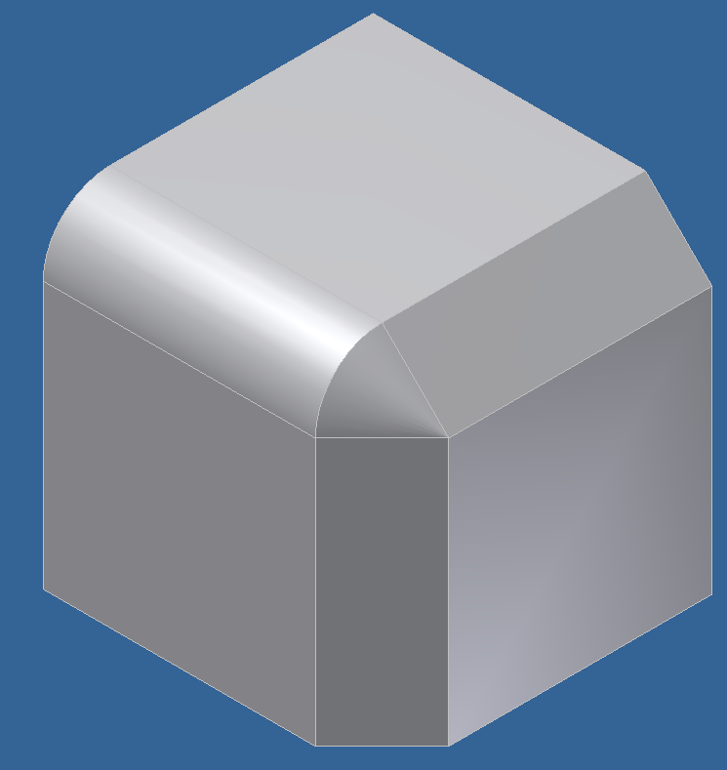
Local Modification Features
Local modification features perform modifications to the existing model and don’t require any profile or path input. For example, Shell, Thread, Fillet, etc.
Require the ability to provide existing geometry as input arguments.

Slide 28
Creating a Fillet - Example
Dim oPartDoc As PartDocument
oPartDoc = _InvApplication.ActiveDocument
Dim oPartDef As PartComponentDefinition
oPartDef = oPartDoc.ComponentDefinition
' Assumes an edge is selected.
Dim oEdge As Edge
oEdge = oPartDoc.SelectSet.Item(1)
‘create edge collection
Dim oEdges As EdgeCollection
oEdges = ThisApplication.TransientObjects.CreateEdgeCollection
oEdges.Add(oEdge)
Dim oFillet As FilletFeature
oFillet = oPartDef.Features.FilletFeatures.AddSimple(oEdges, 0.5)

Slide 29
Definition and Extent Objects
Some objects can have be defined in one of several ways. These definitions can also change over time.
For example, an extrude feature’s extent can be defined as Distance, To Next, To, From To, and All. It’s always the same extrude feature, but the extent type can change.
Other features also have different extent types; revolve, coil, hole, and extrude.
Other objects use this same concept to define their definition; iFeatures, derived parts, work features, holes, chamfer, fillet, and shell.

Slide 30
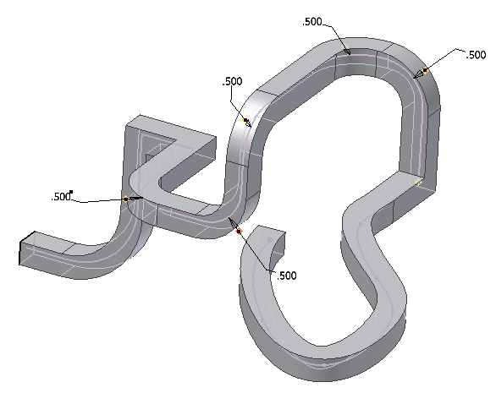
Paths
Paths consist of a combination of 2D and 3D sketches that are positionally connected.
Used as input for the sweep feature, split feature, and rectangular pattern.
When creating, a single entity is provided as input and Inventor finds the chain of all end connected entities.

Slide 31
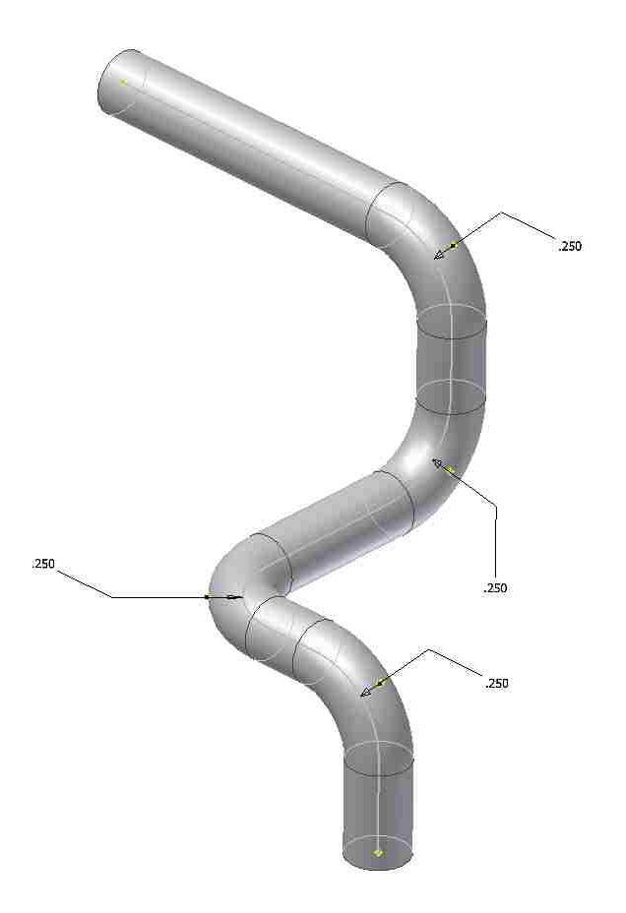
3D Sketches
API supports creation, query, and edit of 3D sketches.
Like 2D sketch entities, 3D sketches are always connected to points (workpoints, 2D sketch points, or model vertices).

Slide 32
3D Sketch
Can create lines, splines, and fixed splines.
Can include existing geometry from the model and other sketches.
Creation of geometric and dimensional constraints.

Slide 33
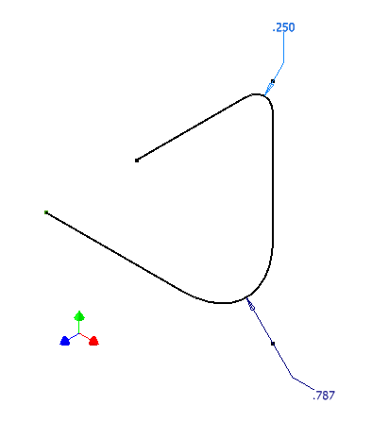
3D Sketch - Example
Public Sub Draw3DSketch()
‘ get active document
Dim oPartDoc As PartDocument
oPartDoc = _InvApplication.ActiveDocument
‘get part component definition
Dim oPartDef As PartComponentDefinition
oPartDef = oPartDoc.ComponentDefinition
‘ add sketch 3d
Dim oSketch3D As Sketch3D
oSketch3D = oPartDef.Sketches3D.Add
Dim oTG As TransientGeometry
oTG = _InvApplication.TransientGeometry
‘ add a sketch line of 3d
Dim oLastLine As SketchLine3D
oLastLine = oSketch3D.SketchLines3D.AddByTwoPoints( _
oPartDef.WorkPoints.Item(1), _
oTG.CreatePoint(5, 0, 0))
‘ add one more sketch line of 3d, using the end point of the first line
oLastLine = oSketch3D.SketchLines3D.AddByTwoPoints( _
oLastLine.EndSketchPoint, _
oTG.CreatePoint(5, 5, 0), _
True, 2)
‘add the third sketch line, using the end point of the second line
oLastLine = oSketch3D.SketchLines3D.AddByTwoPoints( _
oLastLine.EndSketchPoint, _
oTG.CreatePoint(5, 5, 3))
End Sub

Slide 34
Sweep Features
SweepFeatures collection provides various ways of creating a sweep:
AddUsingPath (…)
AddUsingPathAndGuideRail (…)
AddUsingPathAndGuideSurface (…)
AddUsingPathAndSectionTwists (…)
Also it provides some utility methods:
GetProfileOrientationAtParam (…)
GetTruePath (…)
Notes:
'/////////////////////////////////////////////////////////////////////////////////////////////////////////////
'// Use: Various SweepFeatures creation
'//
'//
'/////////////////////////////////////////////////////////////////////////////////////////////////////////////
Public Sub SweepFeature()
Dim oPartDoc As PartDocument
oPartDoc = _InvApplication.Documents.Add(DocumentTypeEnum.kPartDocumentObject, _
_InvApplication.FileManager.GetTemplateFile(DocumentTypeEnum.kPartDocumentObject), _
True)
' Set a reference to the component definition.
Dim oCompDef As PartComponentDefinition
oCompDef = oPartDoc.ComponentDefinition
' Set a reference to the transient geometry object.
Dim oTG As TransientGeometry
oTG = _InvApplication.TransientGeometry
' Create some workpoints that will be used for the 3D sketch.
Dim oWPs(4) As WorkPoint
oWPs(0) = oCompDef.WorkPoints.AddFixed(oTG.CreatePoint(0, 0, 0))
oWPs(1) = oCompDef.WorkPoints.AddFixed(oTG.CreatePoint(3, 0, 0))
oWPs(2) = oCompDef.WorkPoints.AddFixed(oTG.CreatePoint(3, 2, 0))
oWPs(3) = oCompDef.WorkPoints.AddFixed(oTG.CreatePoint(3, 2, 2))
oWPs(4) = oCompDef.WorkPoints.AddFixed(oTG.CreatePoint(6, 2, 2))
' Create a new 3D Sketch.
Dim oSketch3d As Sketch3D
oSketch3d = oPartDoc.ComponentDefinition.Sketches3D.Add
' Draw 3D lines. The first line is drawn between two of the work points.
Dim oLine As SketchLine3D
oLine = oSketch3d.SketchLines3D.AddByTwoPoints(oWPs(0), oWPs(1), True, 1)
' This second and subsequent lines are drawn between a 3D sketch point and a work point.
' The work point is obtained from the previous line. Because the two lines will share
' this 3D sketch point, Inventor will treat them as connected lines when creating any
' paths.
oLine = oSketch3d.SketchLines3D.AddByTwoPoints(oLine.EndPoint, oWPs(2), True, 1)
oLine = oSketch3d.SketchLines3D.AddByTwoPoints(oLine.EndPoint, oWPs(3), True, 0.75)
oLine = oSketch3d.SketchLines3D.AddByTwoPoints(oLine.EndPoint, oWPs(4), True, 1)
' Create a 2D sketch.
Dim oSketch As PlanarSketch
oSketch = oCompDef.Sketches.Add(oCompDef.WorkPlanes.Item(2))
' Determine the model origin relative to the sketch space.
Dim oOrigin As Point2d
oOrigin = oSketch.ModelToSketchSpace(oTG.CreatePoint(0, 0, 0))
' Create two lines.
Dim oNewPoint As Point2d
oNewPoint = oTG.CreatePoint2d(oOrigin.X, oOrigin.Y - 4)
Dim oSketchLine1 As SketchLine
oSketchLine1 = oSketch.SketchLines.AddByTwoPoints(oOrigin, oNewPoint)
oNewPoint.X = oNewPoint.X + 3
Dim oSketchLine2 As SketchLine
oSketchLine2 = oSketch.SketchLines.AddByTwoPoints(oSketchLine1.EndSketchPoint, oNewPoint)
' Create a fillet between the two lines.
Call oSketch.SketchArcs.AddByFillet(oSketchLine1, oSketchLine2, 1, oSketchLine1.StartSketchPoint.Geometry, oSketchLine2.EndSketchPoint.Geometry)
' Get the end of the 2d sketch in model space.
Dim oModelPoint As Point
oModelPoint = oSketch.SketchToModelSpace(oSketchLine2.EndSketchPoint.Geometry)
' Create a work plane at the end of the 2D sketch.
Dim oWP As WorkPlane
oWP = oCompDef.WorkPlanes.AddByNormalToCurve(oSketchLine2, oSketchLine2.EndSketchPoint)
' Create a path. Because the 3D and 2D sketches physically connect the path will include
' both of them.
Dim oPath As Path
oPath = oCompDef.Features.SweepFeatures.CreatePath(oSketchLine2)
' Create a sketch containing a circle.
oSketch = oCompDef.Sketches.Add(oWP)
oOrigin = oSketch.ModelToSketchSpace(oTG.CreatePoint(0, 0, 0))
Call oSketch.SketchCircles.AddByCenterRadius(oSketch.ModelToSketchSpace(oModelPoint), 0.375)
' Create a profile.
Dim oProfile As Profile
oProfile = oSketch.Profiles.AddForSolid
' Create the sweep feature.
Dim oSweep As SweepFeature
oSweep = oCompDef.Features.SweepFeatures.AddUsingPath(oProfile, oPath, PartFeatureOperationEnum.kJoinOperation)
End Sub
Public Sub SweepFeature2()
Dim oPartDoc As PartDocument
oPartDoc = _InvApplication.Documents.Add(DocumentTypeEnum.kPartDocumentObject, _
_InvApplication.FileManager.GetTemplateFile(DocumentTypeEnum.kPartDocumentObject), _
True)
Dim oCompDef As PartComponentDefinition
oCompDef = oPartDoc.ComponentDefinition
Dim oTG As TransientGeometry
oTG = _InvApplication.TransientGeometry
Dim oWPs(1) As WorkPoint
oWPs(0) = oCompDef.WorkPoints.AddFixed(oTG.CreatePoint(0, 0, 0))
oWPs(1) = oCompDef.WorkPoints.AddFixed(oTG.CreatePoint(10, 0, 0))
Dim oSketch3d As Sketch3D
oSketch3d = oPartDoc.ComponentDefinition.Sketches3D.Add
Dim oLine As SketchLine3D
oLine = oSketch3d.SketchLines3D.AddByTwoPoints(oWPs(0), oWPs(1), True, 1)
Dim oFitPoints As ObjectCollection
oFitPoints = _InvApplication.TransientObjects.CreateObjectCollection
oFitPoints.Add(oTG.CreatePoint(0, 0, 2))
oFitPoints.Add(oTG.CreatePoint(2, 0, 1))
oFitPoints.Add(oTG.CreatePoint(4, 0, 3))
oFitPoints.Add(oTG.CreatePoint(6, 0, 2))
oFitPoints.Add(oTG.CreatePoint(8, 0, 1))
oFitPoints.Add(oTG.CreatePoint(10, 0, 0.5))
Dim oSpline As SketchSpline3D
oSpline = oSketch3d.SketchSplines3D.Add(oFitPoints)
Dim oPath As Path
oPath = oCompDef.Features.SweepFeatures.CreatePath(oLine)
Dim oGuideRail As Path
oGuideRail = oCompDef.Features.SweepFeatures.CreatePath(oSpline)
Dim oSketch As PlanarSketch
oSketch = oCompDef.Sketches.Add(oCompDef.WorkPlanes("YZ Plane"))
'Call oSketch.SketchCircles.AddByCenterRadius(oSketch.ModelToSketchSpace(oWPs(1).Point), 0.375)
Call oSketch.SketchLines.AddAsTwoPointRectangle(oSketch.ModelToSketchSpace(oTG.CreatePoint(0, -0.5, -0.5)), _
oSketch.ModelToSketchSpace(oTG.CreatePoint(0, 0.5, 0.5)))
' Create a profile.
Dim oProfile As Profile
oProfile = oSketch.Profiles.AddForSolid
' Create the sweep feature.
Dim oSweep As SweepFeature
oSweep = oCompDef.Features.SweepFeatures.AddUsingPathAndGuideRail(oProfile, oPath, oGuideRail, PartFeatureOperationEnum.kJoinOperation)
End Sub
Public Sub SweepFeature3()
Dim oPartDoc As PartDocument
oPartDoc = _InvApplication.Documents.Add(DocumentTypeEnum.kPartDocumentObject, _
_InvApplication.FileManager.GetTemplateFile(DocumentTypeEnum.kPartDocumentObject), _
True)
Dim oCompDef As PartComponentDefinition
oCompDef = oPartDoc.ComponentDefinition
Dim oTG As TransientGeometry
oTG = _InvApplication.TransientGeometry
Dim oWPs(1) As WorkPoint
oWPs(0) = oCompDef.WorkPoints.AddFixed(oTG.CreatePoint(0, 0, 0))
oWPs(1) = oCompDef.WorkPoints.AddFixed(oTG.CreatePoint(10, 0, 0))
Dim oSketch3d As Sketch3D
oSketch3d = oPartDoc.ComponentDefinition.Sketches3D.Add
Dim oLine As SketchLine3D
oLine = oSketch3d.SketchLines3D.AddByTwoPoints(oWPs(0), oWPs(1), True, 1)
Dim oFitPoints As ObjectCollection
oFitPoints = _InvApplication.TransientObjects.CreateObjectCollection
oFitPoints.Add(oTG.CreatePoint(0, 0, 1))
oFitPoints.Add(oTG.CreatePoint(2, 1, 0))
oFitPoints.Add(oTG.CreatePoint(4, 0, -1))
oFitPoints.Add(oTG.CreatePoint(6, -1, 0))
oFitPoints.Add(oTG.CreatePoint(8, 0, 1))
oFitPoints.Add(oTG.CreatePoint(10, 1, 0))
Dim oSpline As SketchSpline3D
oSpline = oSketch3d.SketchSplines3D.Add(oFitPoints)
Dim oPath As Path
oPath = oCompDef.Features.SweepFeatures.CreatePath(oLine)
Dim oGuideRail As Path
oGuideRail = oCompDef.Features.SweepFeatures.CreatePath(oSpline)
Dim oSketch As PlanarSketch
oSketch = oCompDef.Sketches.Add(oCompDef.WorkPlanes("YZ Plane"))
Call oSketch.SketchLines.AddAsTwoPointRectangle(oSketch.ModelToSketchSpace(oTG.CreatePoint(0, -0.5, -0.5)), _
oSketch.ModelToSketchSpace(oTG.CreatePoint(0, 0.5, 0.5)))
' Create a profile.
Dim oProfile As Profile
oProfile = oSketch.Profiles.AddForSolid
' Create the sweep feature.
Dim oSweep As SweepFeature
oSweep = oCompDef.Features.SweepFeatures.AddUsingPathAndGuideRail(oProfile, oPath, oGuideRail, PartFeatureOperationEnum.kJoinOperation)
End Sub
Public Sub SweepFeature4()
Dim oPartDoc As PartDocument
oPartDoc = _InvApplication.Documents.Add(DocumentTypeEnum.kPartDocumentObject, _
_InvApplication.FileManager.GetTemplateFile(DocumentTypeEnum.kPartDocumentObject), _
True)
Dim oCompDef As PartComponentDefinition
oCompDef = oPartDoc.ComponentDefinition
Dim oTG As TransientGeometry
oTG = _InvApplication.TransientGeometry
Dim oSketch3d As Sketch3D
oSketch3d = oPartDoc.ComponentDefinition.Sketches3D.Add
Dim oFitPoints As ObjectCollection
oFitPoints = _InvApplication.TransientObjects.CreateObjectCollection
oFitPoints.Add(oTG.CreatePoint(0, 0, 0))
oFitPoints.Add(oTG.CreatePoint(2, 0, 0))
oFitPoints.Add(oTG.CreatePoint(4, 0, 0))
Dim oSpline As SketchSpline3D
oSpline = oSketch3d.SketchSplines3D.Add(oFitPoints)
Dim oTwistPoints As ObjectCollection
oTwistPoints = _InvApplication.TransientObjects.CreateObjectCollection
Call oTwistPoints.Add(oSpline.FitPoint(1))
Call oTwistPoints.Add(oSpline.FitPoint(2))
Call oTwistPoints.Add(oSpline.FitPoint(3))
Dim oTwistVectors As ObjectCollection
oTwistVectors = _InvApplication.TransientObjects.CreateObjectCollection
oTwistVectors.Add(oTG.CreateUnitVector(0, 0, 1))
oTwistVectors.Add(oTG.CreateUnitVector(0, -1, 0))
oTwistVectors.Add(oTG.CreateUnitVector(0, 1, 0))
Dim oPath As Path
oPath = oCompDef.Features.SweepFeatures.CreatePath(oSpline)
Dim oSketch As PlanarSketch
oSketch = oCompDef.Sketches.Add(oCompDef.WorkPlanes("YZ Plane"))
Call oSketch.SketchLines.AddAsTwoPointRectangle(oSketch.ModelToSketchSpace(oTG.CreatePoint(0, -0.5, -0.5)), _
oSketch.ModelToSketchSpace(oTG.CreatePoint(0, 0.5, 0.5)))
' Create a profile.
Dim oProfile As Profile
oProfile = oSketch.Profiles.AddForSolid
' Create the sweep feature.
Dim oSweep As SweepFeature
oSweep = oCompDef.Features.SweepFeatures.AddUsingPathAndSectionTwists(oProfile, oPath, PartFeatureOperationEnum.kJoinOperation, oTwistPoints, oTwistVectors)
End Sub

Slide 35
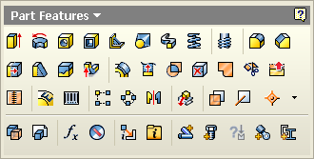
Work Features
Full construction, query and edit is supported for all types of work features; planes, axes, and points.
In addition to grounded work points, the API also supports grounded work planes and axes.
Supported for assembly documents, but only the AddFixed method is supported. This creates a work plane within the assembly and then assembly constraints are used to control its position.

Slide 36
Accessing Existing Work Features
Work features are enumerated by the collections in the same order as they appear in the browser.
Can be accessed by name. (Names may be different for different languages of Inventor.)
Public Sub GetWorkFeatures()
Dim oPartDef As PartComponentDefinition
oPartDef = _InvApplication.ActiveDocument.ComponentDefinition
' Get the X-Y Plane work plane.
Dim oXYPlane As WorkPlane
oXYPlane = oPartDef.WorkPlanes.Item(3)
Debug.Print(oXYPlane.Name)
' Get the origin point.
Dim oOriginPoint As WorkPoint
oOriginPoint = oPartDef.WorkPoints.Item(1)
Debug.Print(oOriginPoint.Name)
End Sub

Slide 37
Creating Work Features
Various add methods supported for the different techniques of creating work features.
Construction argument to True creates an invisible work feature (for the user).
Public Sub CreateWorkFeatures()
Dim oPartDef As PartComponentDefinition
oPartDef = _InvApplication.ActiveDocument.ComponentDefinition
Dim oPlane1 As WorkPlane
oPlane1 = oPartDef.WorkPlanes.AddByPlaneAndOffset(oPartDef.WorkPlanes.Item(1), 4)
Dim oAxis1 As WorkAxis
oAxis1 = oPartDef.WorkAxes.AddByTwoPlanes(oPlane1, oPartDef.WorkPlanes.Item(2))
Dim oPlane2 As WorkPlane
oPlane2 = oPartDef.WorkPlanes.AddByLinePlaneAndAngle(oAxis1, oPlane1, _
System.Math.PI / 4)
End Sub
Notes:
'/////////////////////////////////////////////////////////////////////////////////////////////////////////////
'// Use: WorkFeatures Creation
'//
'//
'/////////////////////////////////////////////////////////////////////////////////////////////////////////////
Public Sub CreateWorkFeatures()
Dim oPartDef As PartComponentDefinition
oPartDef = _InvApplication.ActiveDocument.ComponentDefinition
Dim oPlane1 As WorkPlane
oPlane1 = oPartDef.WorkPlanes.AddByPlaneAndOffset(oPartDef.WorkPlanes.Item(1), 4)
Dim oAxis1 As WorkAxis
oAxis1 = oPartDef.WorkAxes.AddByTwoPlanes(oPlane1, oPartDef.WorkPlanes.Item(2))
Dim oPlane2 As WorkPlane
oPlane2 = oPartDef.WorkPlanes.AddByLinePlaneAndAngle(oAxis1, oPlane1, 3.14159 / 4)
End Sub

Slide 38
Querying/Editing Work Features
The work feature objects support general functionality that applies to all work features.
From each work feature you can get a Definition object which specifies how the work feature was constructed and provides access to the referenced entities.
You can edit properties of the Definition object to edit the work feature.
You can use the various Set methods of the object to change it from one definition type to another.
Notes:
'/////////////////////////////////////////////////////////////////////////////////////////////////////////////
'// Use: WorkFeatures Definition change
'//
'//
'/////////////////////////////////////////////////////////////////////////////////////////////////////////////
Public Sub ChgWorkFeatureDef()
Dim oPartDef As PartComponentDefinition
oPartDef = _InvApplication.ActiveDocument.ComponentDefinition
Dim oPlane2 As WorkPlane
oPlane2 = oPartDef.WorkPlanes(5)
'Change the WorkPlane Definition
Call oPlane2.SetByTwoLines(oPartDef.WorkAxes(1), oPartDef.WorkAxes(4))
End Sub

Slide 39
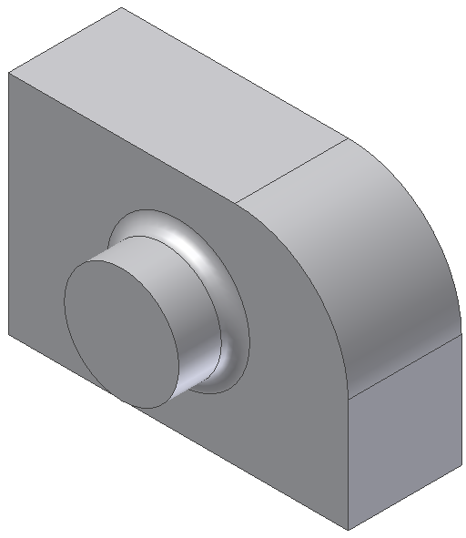
Lab: Sketches and Features
Create a .Net Exe using the API:
Create a new part document.
Create a sketch on the X-Y plane.
Draw the entities that define the main shape of the part. (The dimensions don’t matter and constraints are optional.)
Create an extrusion.
Next step: How to add the next sketch to create the cylindrical extrusion and then the fillet?

Slide 40
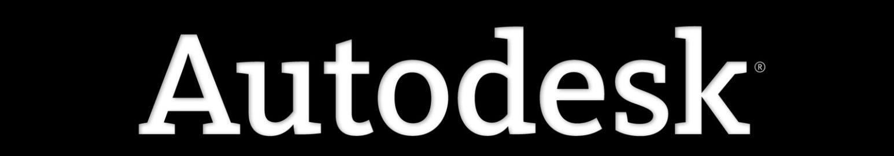
Notes:
Thank you!
Questions?

